Slide 1
Museum Rentals Corporate | Social

Slide 2
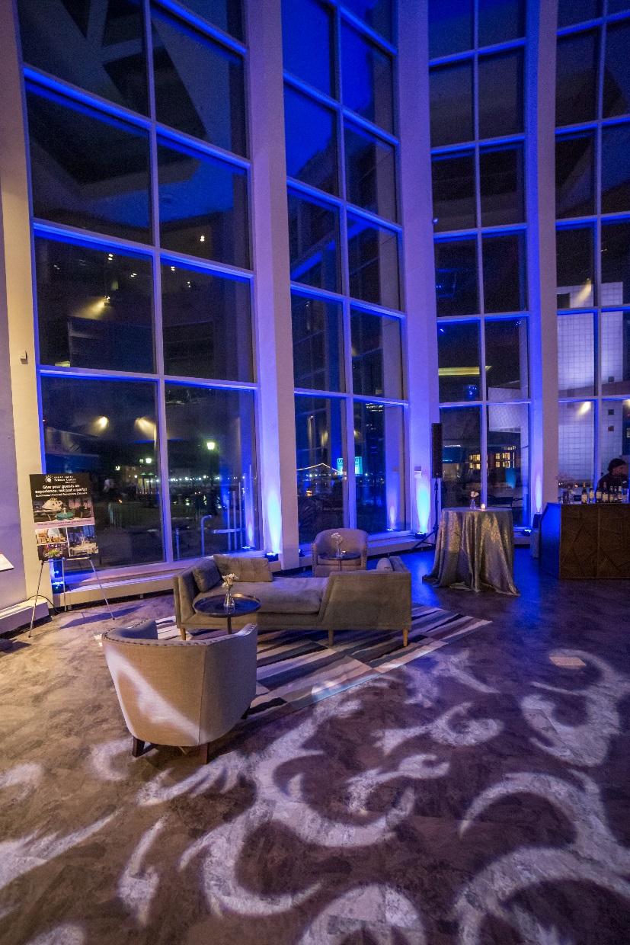
Event rentals
Great Lakes
Science Center
From a magnificent celebration to an intimate gathering, enjoy the best views of downtown Cleveland and Lake Erie from any of the museum’s spacious floors, exhibits or outdoor decks.
Rent the full museum or by floor. Event space is available for daytime and evening events. Guests will be entertained for hours as they explore one of our three interactive exhibit spaces!
Convenient parking is available in the museum’s attached garage and included with evening rentals or offered at a discounted rate for daytime events!
Contact the Sales & Special Events Manager for more details.

Slide 3
Event spaces
(Pricing subject to change)
Rental Space | Banquet | Theater Style | Reception | Daytime Monday - Friday | Evening Sunday-Thursday / Friday & Saturday
Full Museum | 2,500 -4,000 |  |  | N/A | $7,500 / $9,000
Promenade | 150 -250 | 100 | 300 | N/A | $3,000 / $3,500
Reinberger Auditorium (Full day rental includes admission and parking) | 120 | 150 | 200 | Half Day $750 Full Day $1,000 | $1,000 / $1,500
Cleveland Clinic DOME Theater (film: optional) | N/A | 290 | N/A | Priced upon request | $3,000 ($1,200 when paired with an event space)
Level 1 NASA Glenn Visitors Center (Includes outdoor deck) | 100 | N/A | 250 | N/A | $2,750 / $3,500
Level 2 Bytes & Alcove | 180 | 150 | 250 | $750 - $1,200 | Included with Science Phenomenon Exhibit rental
Level 2 Science Phenomena Exhibit (Includes outdoor deck) | 180 | N/A | 400 | N/A | $2,750 /$3,000
Mezzanine | 80 | 100 | 100 | $500 | N/A
Outdoor Patio (North Coast Harbor side) | 150-250 | N/A | 250 | Priced upon request | Priced upon request
Outdoor Lawns (Cityscape lawn or Front Lawn) | 2,000 | N/A | 2,000 + | $2,000 | Priced upon request
Traveling Exhibit Gallery (Limited Availability) | 350 | 500 - 800 | 800 + | Priced Upon Request | $4,500

Slide 4
Rental information
Rental Information:
Great Lakes Science Center requires that you provide a certificate of insurance for event rentals
A 25% deposit is required with the signed contract to hold a specific date and space
Events that are serving alcohol will require a CPD Off Duty Police Officer to be on-site, which is billed at $45 per hour for a minimum of 5 hours
All food, beverage and alcohol will be purchased and served by the museum’s exclusive catering provider Levy Restaurants
Levy Restaurants will provide a separate quote for food and beverage costs. For catering questions please contact their Sales Manager at 440-537-1835.
Great Lakes Science Center is a smoke free facility.
Nonprofit organizations are eligible to receive a 15% discount off facility rental fees with a 501 (c)(3) certificate
Evening Event Rentals
Rental pricing is based on use of the space for 4 hours starting any time after 6 p.m.
All EVENING event rentals include complimentary parking in the museum’s attached garage
Great Lakes Science Center has the following inventory of equipment that is included with the rental:
(25) 60” round tables
(25) 8’ tables
(200) white folding chairs with padded seat
(275) banquet chairs with black fabric seat
Lectern with wireless handheld microphone
There is no additional cost for admission to the museum for evening events
Daytime Event Rentals:
Daytime rentals take place between the hours of 8 a.m. – 5 p.m.
Parking for daytime events in the museum’s garage is offered at a discounted rate of $7 per car
Great Lakes Science Center offers several options for teambuilding activities and interactive science shows. A menu of options and pricing can be provided upon request.
Admission to the museum is not included with daytime rentals unless noted. For groups of 10 or more, group rate discounted pricing will be offered:
 | Museum Admission | DOME Theater | William G. Mather | Museum + DOME | Museum + W.G. Mather | DOME + W.G. Mather | All 3
Adults | $12.72 | $9.54 | $6.36 | $16.96 | $16.96 | $14.84 | $20.14
Youth (2 -12) | $10.60 | $7.42 | $6.36 | $14.84 | $14.84 | $12.72 | $18.02

Slide 5
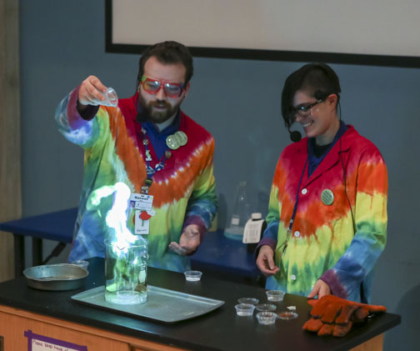
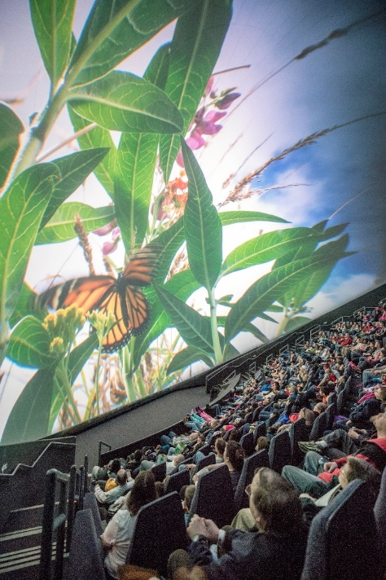
Event enhancements
Big Science Show! | $150 per show
See science come to life in a fun and interactive show. Choose from It’s Electric, Lift Off, Magic of Matter or Force and Motion. Show length ranges from 25-35 minutes long.
Team Building | $125 per group of 25
Take your meeting out of the board room and into Great Lakes Science Center! Enjoy a friendly competition amongst co-workers with a team building activity. Choose from one of our most popular options; Egg Drop Challenge, Spaghetti Tower or Paper Table Challenge. Challenges range from 30 – 90 minutes.
Scavenger Hunt | Complimentary!
Renting the NASA Glenn Visitor Center and Science Phenomena exhibit for your event? Take your guests on a hunt as they explore their way through each gallery!
DOME Theater | Priced upon request
Show your guests a larger than life movie experience on the DOME’s 79-foot screen. Select from one of the museum’s daily features. Movies are 45-50 minutes each.

Slide 6
Exhibit spaces
Level 1: NASA Glenn Visitor Center
Explore the past, present and future of human space exploration and understand the challenges that humans have solved to travel to space, explore space and return to earth safely. Look inside the actual 1973 Skylab 3 Apollo Command Module, experience a multi-media trip through landmark moments in space history, see artifacts from John Glenn’s February 20, 1962 Friendship 7 mission, check out a real moon rock and more!
BIO Med Tech Gallery (Located inside NASA exhibit)
Enter the fascinating world of biomedical technology and engineering. Explore interactive exhibits, videos and educational displays focusing on genomics, stem cells, prosthetics, functional electrical stimulation (FES) and medical imaging. Discover how these cutting-edge technologies impact our lives. Control a prosthetic arm. Learn about positron emission tomography (PET) scan technology. Get up close to a magnetic resonance imaging (MRI) machine. Explore the inside of a stomach with an endoscopic camera and so much more!
Level 2: Science Phenomena Exhibit
Have you ever wondered: How does that work? Why did it do that? What would happen if I changed it? These are the questions asked by scientists as they explore the world around us. Here’s your chance to meet your inner scientist as you explore electricity and magnetism; light and optics; motion and mechanics; sound and resonance; and more.
Traveling Special Exhibitions
VROOM! A car adventure March 15, 2019 – September 2, 2019
TBD – Fall/Winter 2019
*Exhibit spaces are only available for private use for evening rentals. Food and beverage are allowed on exhibit floors during private events.

Slide 7
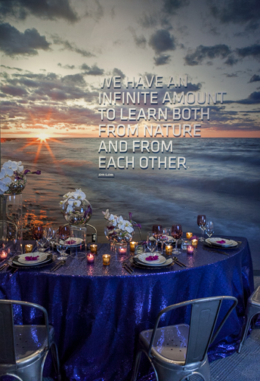
Event spaces
Great Lakes Science Center offers many options for private events. The museum has stunning views of Lake Erie from both its indoor and outdoor event spaces. Choose from an exhibit floor, outdoor deck or the spacious Promenade Level to host a truly unique experience for your guests.
Check out some of the pictures of our amazing event spaces!

Slide 8
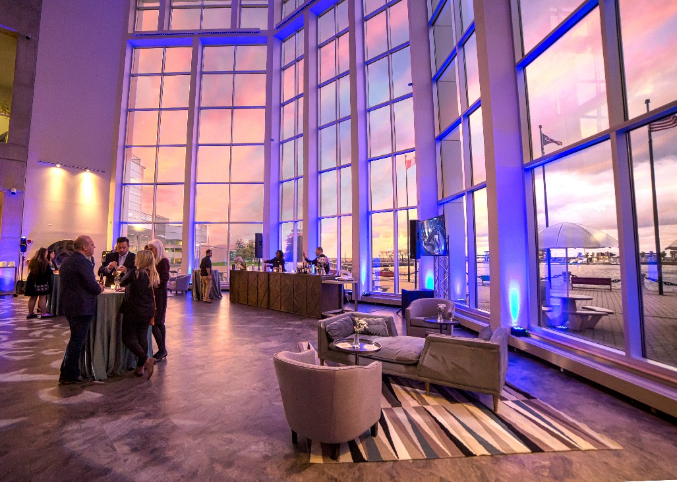
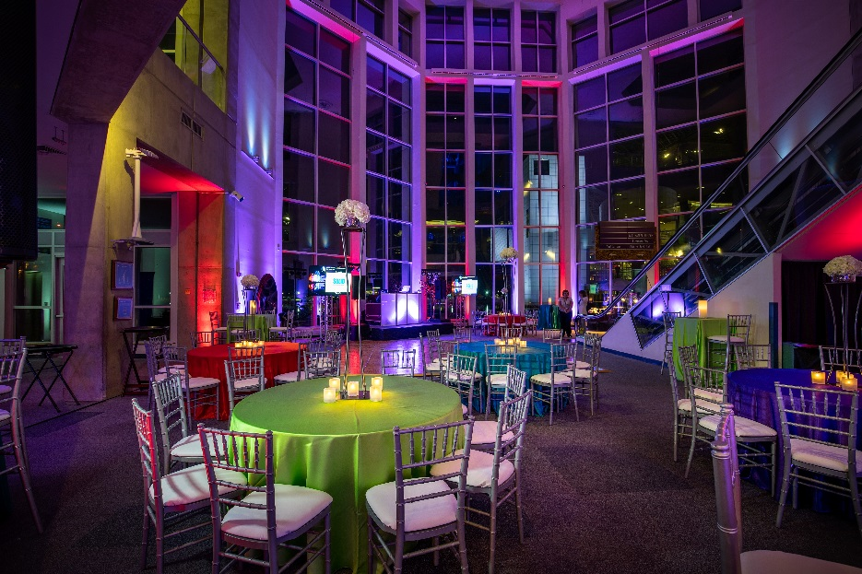
Promenade

Slide 9
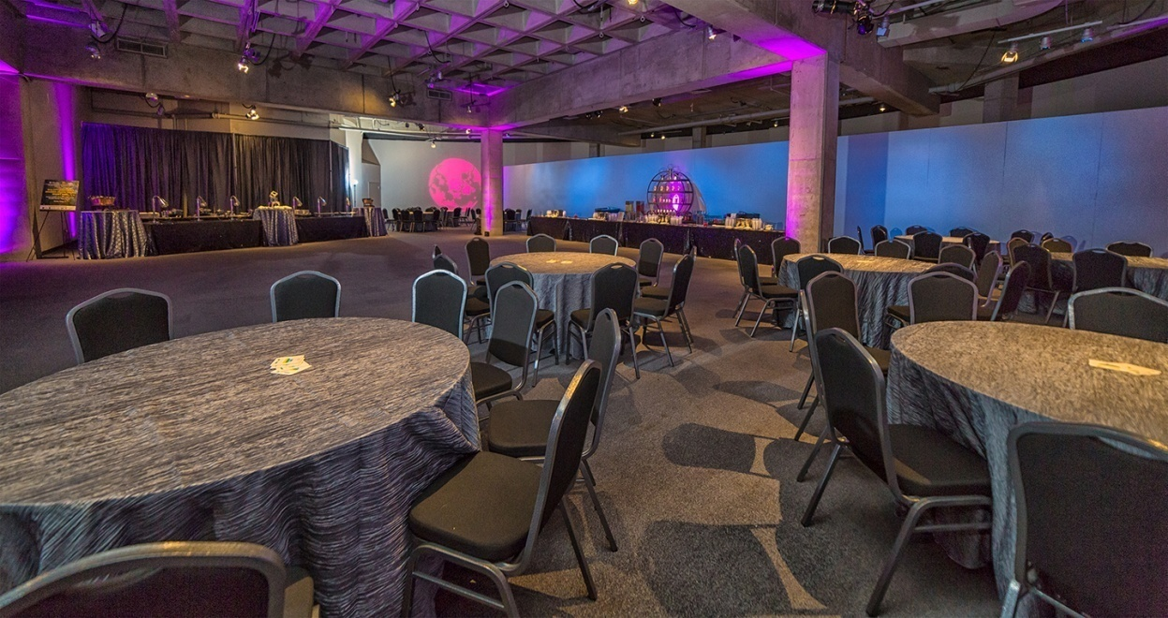
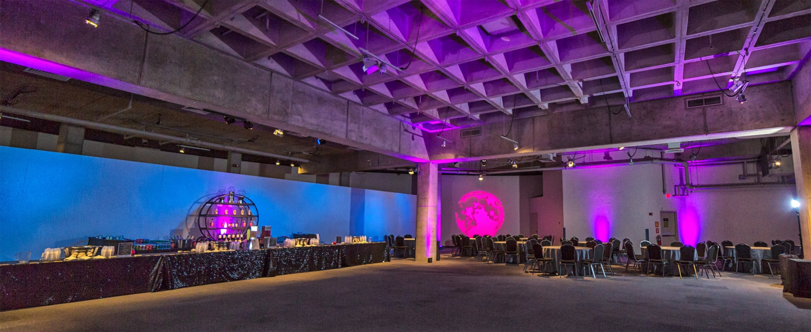
Traveling Exhibit gallery
*This space has limited availability

Slide 10
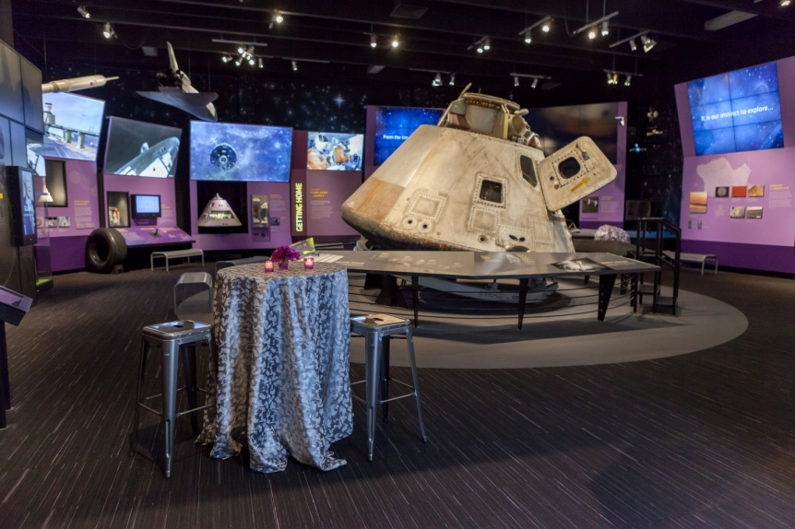
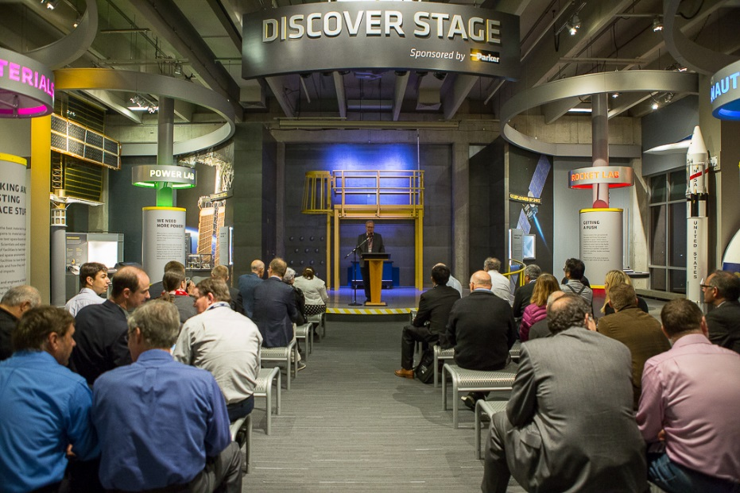
Nasa Glenn visitor center

Slide 11
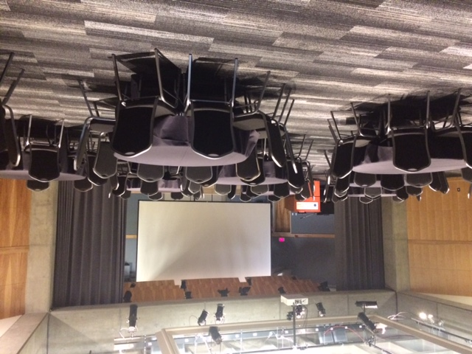
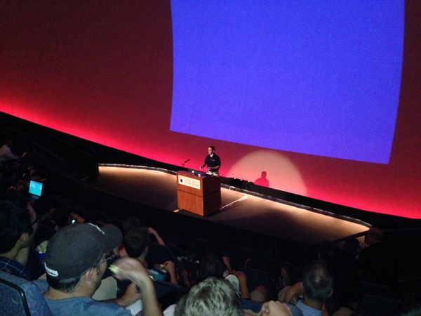
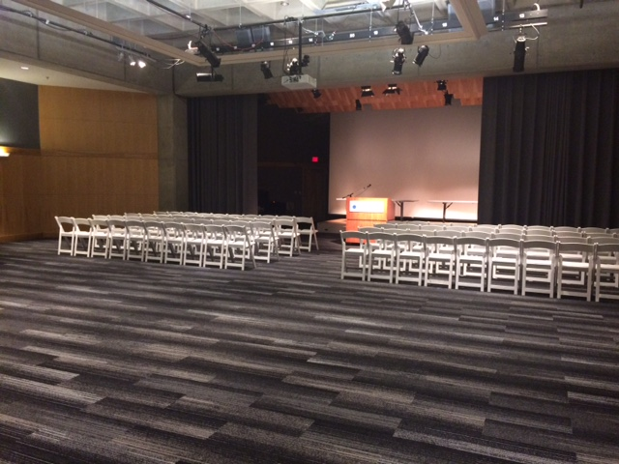
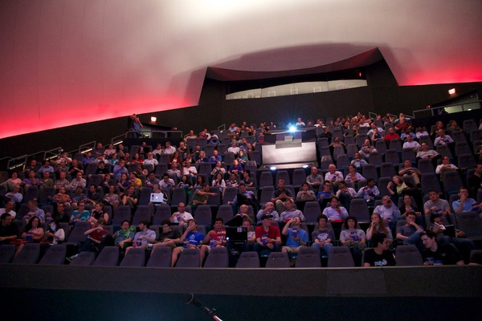
REINBERGER Auditorium / DOME Theater

Slide 12
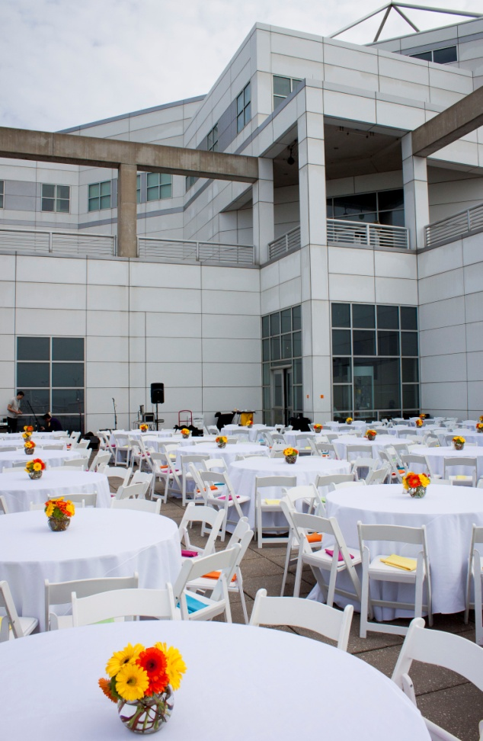
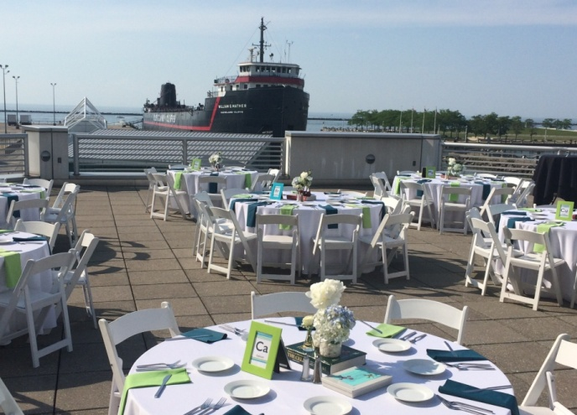
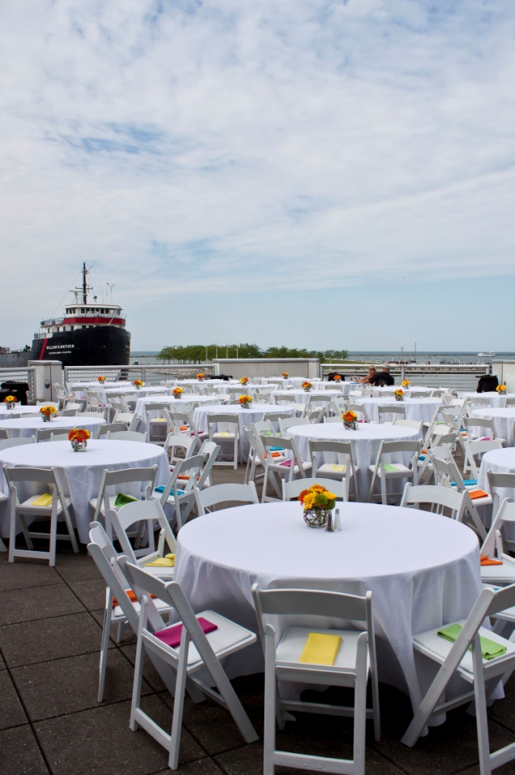
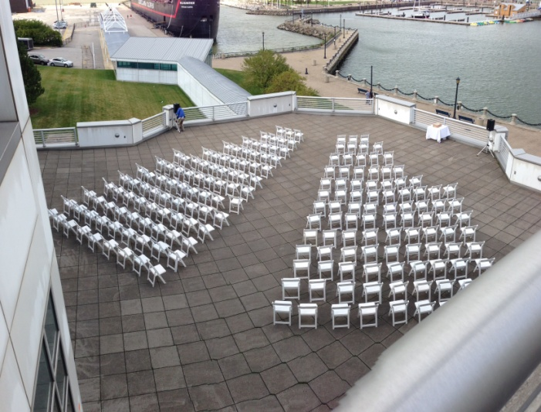
Level 1 Deck

Slide 13
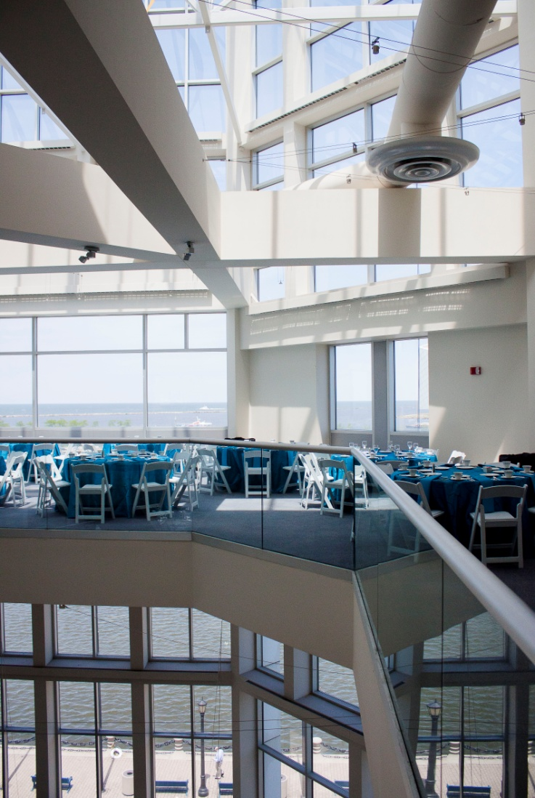
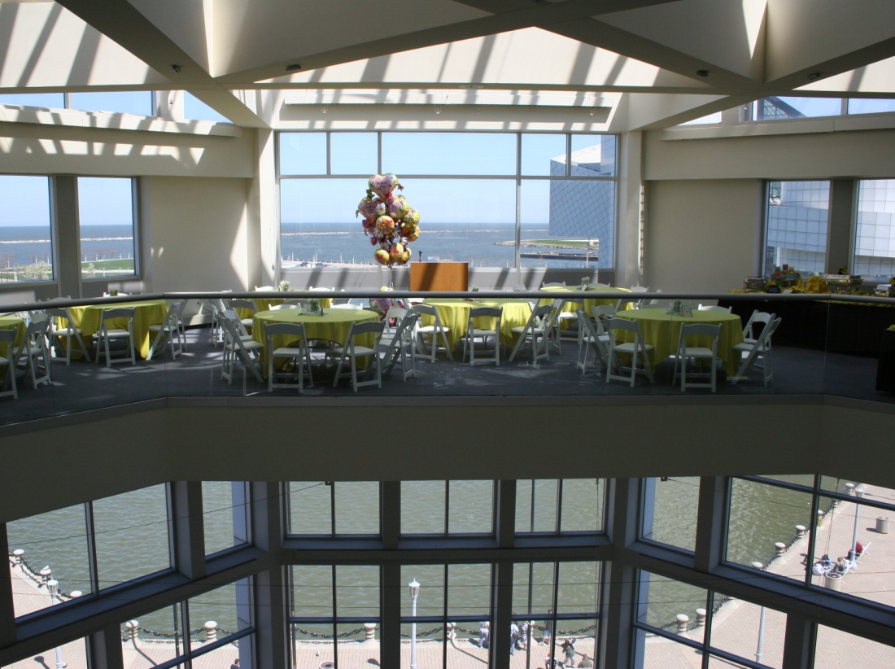
Mezzanine

Slide 14
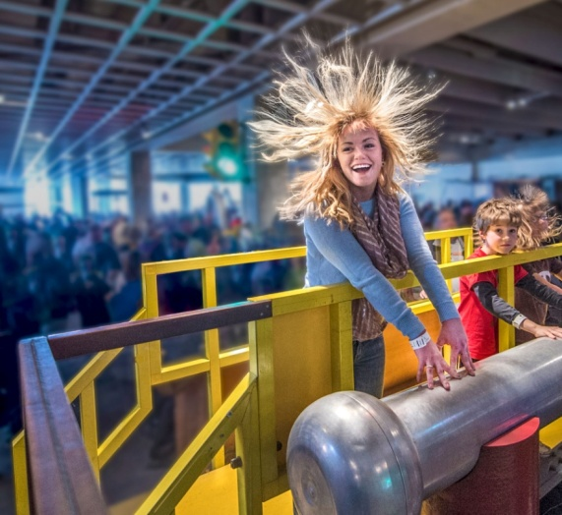
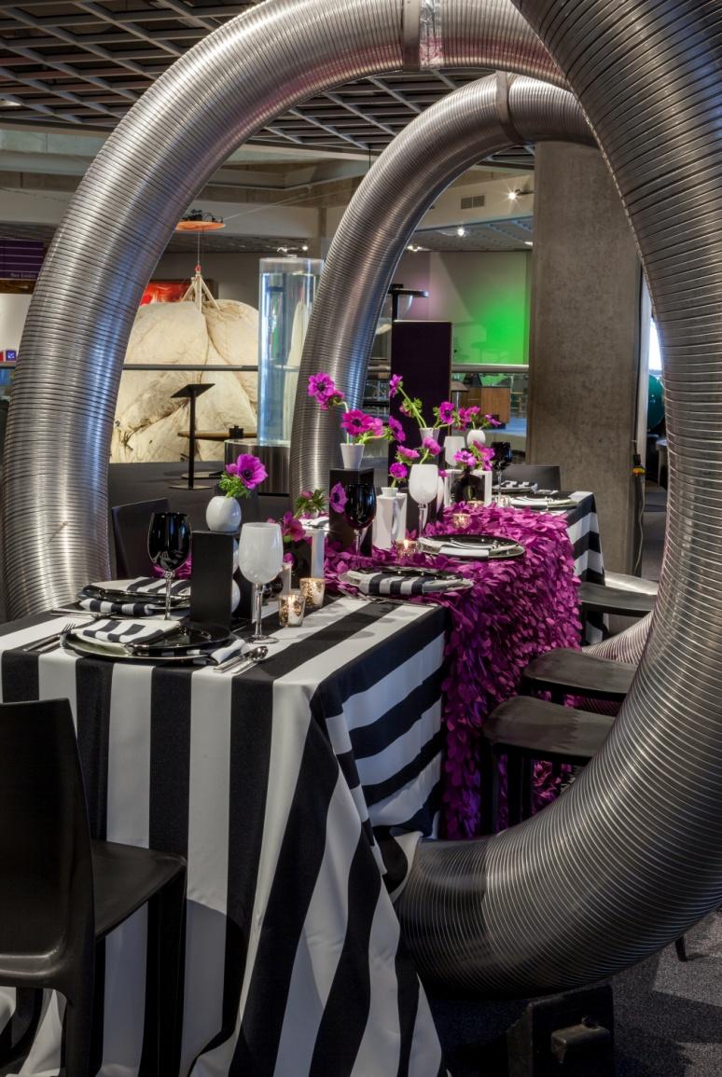
Science Phenomena Exhibit

Slide 15
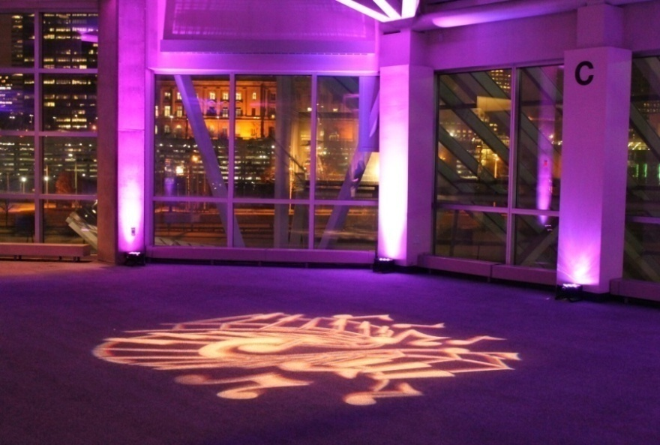
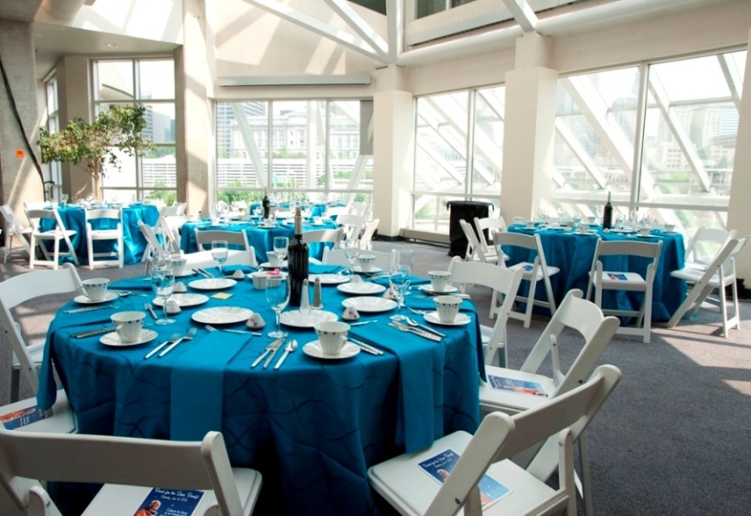
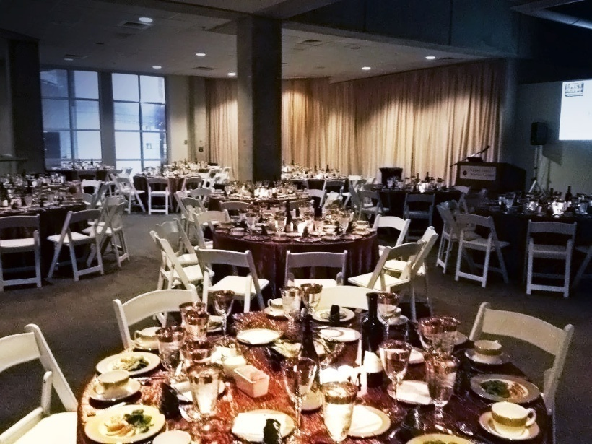
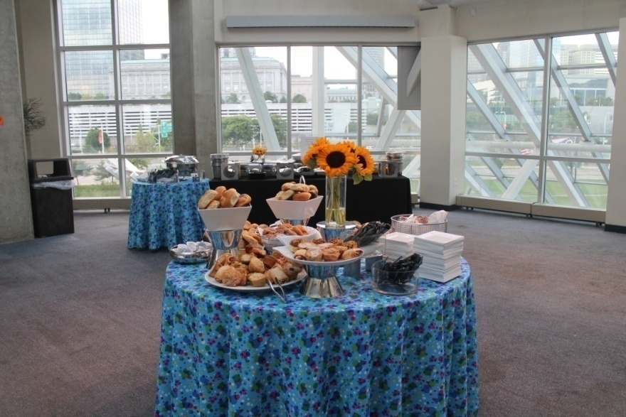
Bytes & alcove

Slide 16
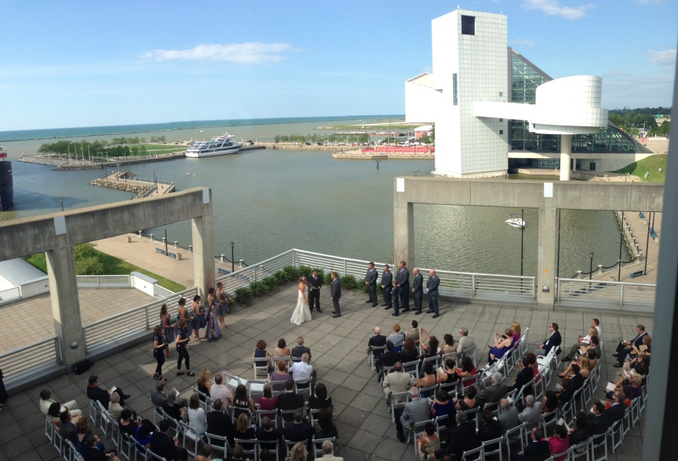
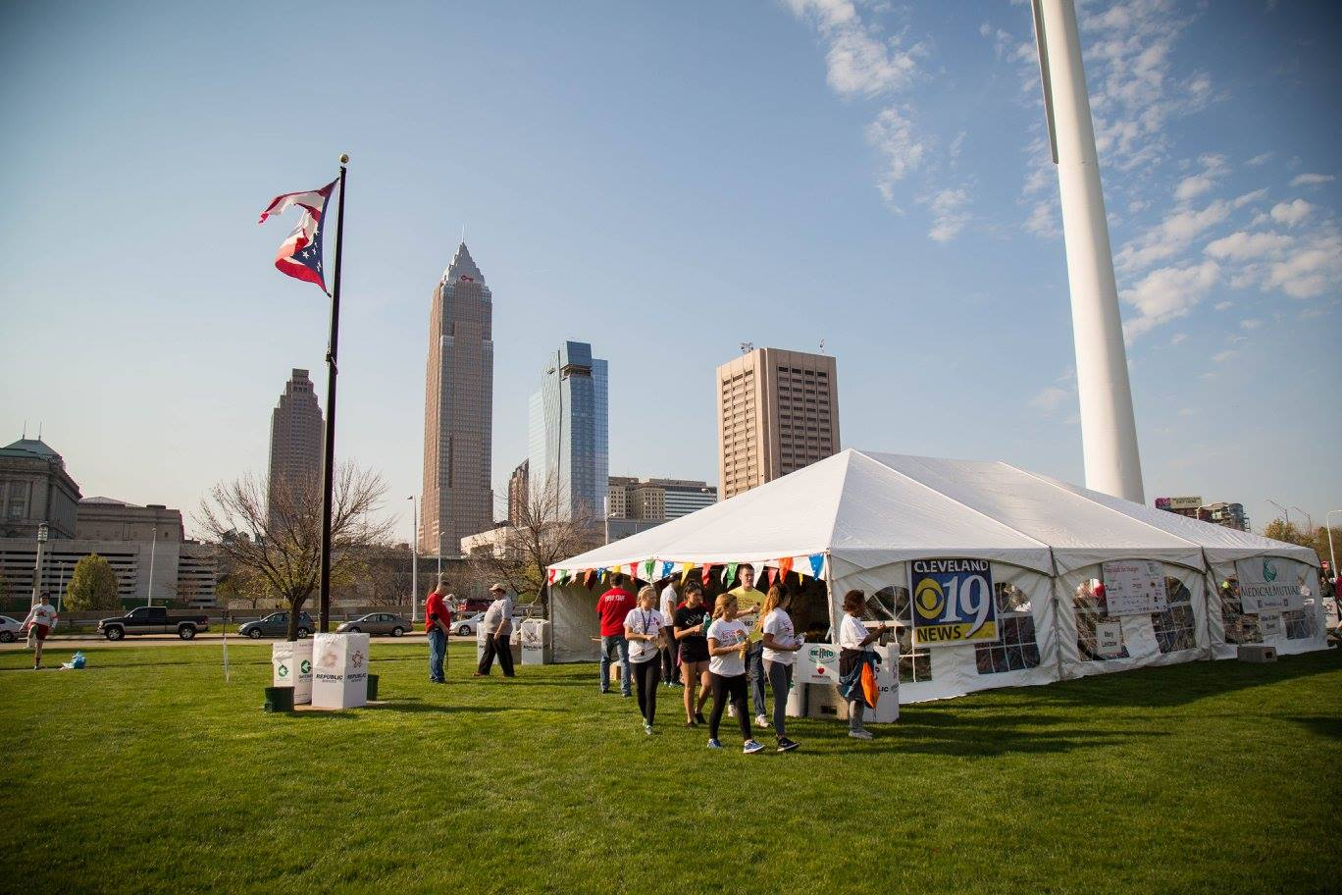
level 2 deck / Front Lawn

Slide 17
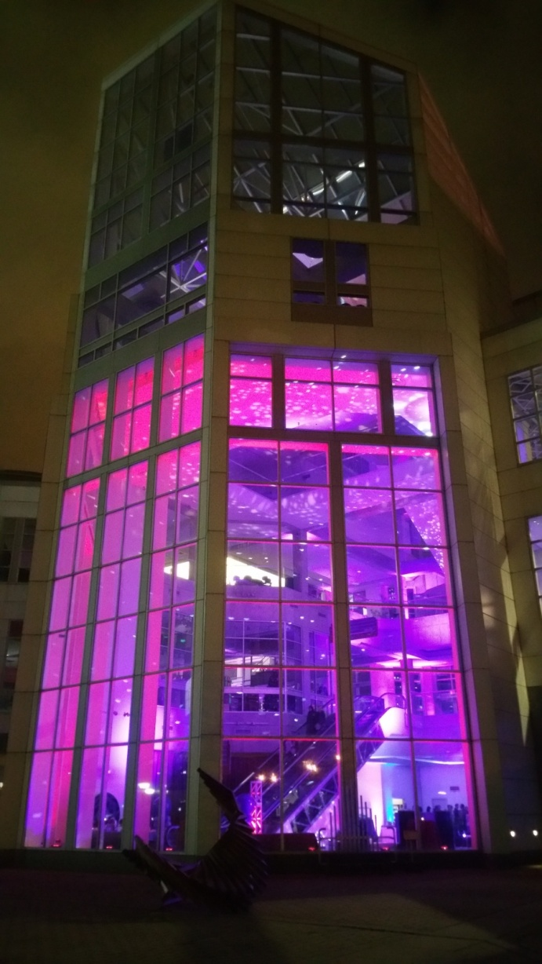
Contact information
For questions about renting the Science Center
or to schedule a tour contact:
Linda Borelli
Special Events Manager
Great Lakes Science Center
BorrelliL@glsc.org
216-696-4941
Becki Trivison
Special Events Assistant
Great Lakes Science Center
TrivisonR@glsc.org
216-696-2219
For questions about catering contact:
Meghan Welte
Catering Sales Manager
Levy Restaurants at Great Lakes Science Center
mwelte@levyrestaurants.com
216-696-4481
Great Lakes Science Center
601 Erieside Ave
Cleveland , OH 44114
GreatScience.com

